Slide 1

Policies for Municipal Treasurers
Guidelines shaping local governance and community development
This Photo by Unknown Author is licensed under CC BY-NC-ND
Notes:
Susan Gage, Treasurer and Clerk in Brandon since 2014. Background in Accounting which helps.
Any new treasurers? Do people use NEMRC? Or something else?
As Treasurers we are the fiscal stewards of the public monies. We want to account for it, help it grow where it can, and help create a fiscal sustainability in our towns.
To do that we should have clear, consistent, guidelines in the form of written policies..
Does anyone NOT have policies in their municipalities?

Slide 2
Introduction to Financial Policies
Purpose and Importance
  Financial policies establish clear guidelines that ensure disciplined and transparent financial management aligned with strategic goals.
Consistency and Continuity
  Policies maintain consistent financial decision-making over time, minimizing dependence on individual judgments or political changes.
Risk Management and Planning
  Financial policies prepare organizations to manage revenues, expenses, reserves, and debt minimizing risk to assets.
Communication and Accountability
  Policies communicate clear decision-making rules internally and demonstrate fiscal responsibility to external stakeholders.
This Photo by Unknown Author is licensed under CC BY-NC-ND
Notes:
Financial policies are formal, written guidelines that define how an organization manages its financial resources in a disciplined, consistent, and transparent manner.
Accountability to taxpayers by clarifying financial intent, codifying acceptable practices.
At a high level, financial policies institutionalize good financial management practices so that decision-making does not depend solely on individual judgment or short-term political pressures.
They provide continuity over time, even as staff members or elected officials change, ensuring that the organization remains aligned with long-term objectives.
Financial policies also help organizations proactively address uncertainty by setting expectations for how revenues, expenditures, reserves, and debt will be managed thereby reducing risk to assets.
“Coventry Issue” risk of money disappearing
Another critical role of financial policies is communication. Policies clearly explain to internal staff how financial decisions should be made and implemented, while also signaling to external audiences—such as rating agencies, auditors, and the public—that the organization is committed to prudent fiscal stewardship.
By establishing clear rules and boundaries, financial policies reduce ambiguity, support ethical behavior, and promote consistency in financial operations. Overall, financial policies are not just technical documents; they are strategic tools that guide behavior, support credibility, and strengthen the long-term financial health of an organization.

Slide 3

Financial Management Policies
Budget Development and Approval
  Budget policies define timelines, roles, and criteria to align spending with strategic priorities and community needs.
Revenue and Asset Management
  Policies ensure fair collection of revenues and guide maintenance and replacement of municipal infrastructure.
Auditing and Financial Reporting
  Regular audits and transparent reporting promote accountability and identify inefficiencies early.
Financial Resilience and Sustainability
  Policies establish guidelines for reserves, debt management, and emergency spending to support fiscal resilience.
Notes:
Policies guide how public funds are planned, collected, spent, and monitored, ensuring responsible stewardship of taxpayer resources.
Core areas typically include budget development and approval processes, financial controls, auditing requirements, and reporting standards.

Slide 4

Common Types of Financial Policies
Fund Balance and Reserve Policies
  These policies define reserve levels to ensure resources for cash flow, emergencies, and economic downturns.
Debt Management Policies
  Guidelines for issuing debt, acceptable limits, and repayment to promote responsible borrowing.
Investment and Revenue Policies
  Policies ensuring safe, liquid investments and diversified, reliable revenue sources.
Expenditure and Capital Policies
  Guidelines for spending control and planning financing for infrastructure and assets.
This Photo by Unknown Author is licensed under CC BY-SA-NC
Notes:
Fortunately we have the VMCTA, VLCT, and the Secretary of State to help us define policy needs, and to help us create policies.
Developing effective financial policies is a deliberate and structured process that begins with clearly defining the problem or issue the policy is intended to address. This initial step ensures that the policy is purposeful and directly linked to organizational needs, risks, or strategic goals. Without a clearly defined problem, policies risk being overly generic or misaligned with actual challenges.
The next step involves drafting the policy itself. During this phase, organizations should consider applicable legal requirements, industry best practices, and experiences of peer organizations. Input from finance staff, legal counsel, and other stakeholders can help ensure the policy is practical, compliant, and comprehensive. In some cases, public input or feedback from governing bodies may also be appropriate.
Once drafted, the policy should be reviewed and formally presented to senior management and elected officials. This step promotes transparency, builds understanding, and allows decision-makers to ask questions or request revisions. Formal adoption by the governing body gives the policy authority and legitimacy. Finally, implementation and communication are critical. Policies must be shared with staff, integrated into procedures, and referenced during budgeting and financial decisions to ensure they are actively used rather than simply filed away.
Organizations typically adopt a comprehensive framework of financial policies that address multiple aspects of financial management. One of the most common categories is fund balance and reserve policies, which define appropriate reserve levels for the general fund and other funds. These policies help ensure that sufficient resources are available to manage cash flow, respond to emergencies, and weather economic downturns.
Debt policies are another critical category, establishing guidelines for when debt may be issued, acceptable debt levels, and repayment structures. These policies promote responsible borrowing and protect the organization from overleveraging. Investment policies define how public funds are invested, emphasizing safety, liquidity, and yield, while ensuring compliance with legal requirements.
Additional policy areas often include revenue policies, which address diversification, elasticity, and reliability of revenue sources, and expenditure policies, which guide spending growth and cost controls. Capital policies govern planning and financing for infrastructure and long-term assets, while operating budget policies emphasize structural balance and recurring revenues. Other common policies cover grants management, procurement, risk management, internal controls, accounting and financial reporting, and long-term financial planning. Together, these policies form an integrated system that supports financial stability and strategic decision-making.

Slide 5
Resources
https://vmcta.org/
https://www.vtgfoa.org/
https://www.gfoa.org/
https://nesgfoa.com/
https://www.vlct.org/
https://www.vermonttreasurer.gov/
https://finance.vermont.gov/reports-and-publications/town-payment-reports-and-data
https://auditor.vermont.gov/
https://sam.gov/content/home

Slide 6
1. General fund reserves. Policies governing the amount of resources to be held in reserve and conditions under which reserves can be used.
2. Reserves in other funds. Policies for other funds (especially enterprise funds) that serve a similar purpose to general fund reserve policies.
3. Structurally balanced budget. Policies that offer a distinction between satisfying the statutory definition and achieving a true structurally balanced budget.
GFOA
Notes:
1) Define required reserve levels and conditions for use
2) Provide structure for reserves in enterprise and special revenue funds
3) Distinguish statutory balanced budgets from structurally balanced budgets
4) Reinforce fiscal discipline and stability in annual budgeting
Municipal financial policies regarding general fund reserves ensure stability, maintaining essential services during economic downturns or unexpected emergencies. The Government Finance Officers Association (GFOA) recommends maintaining at least two months of operating expenditures or revenues (approx. 16.7% or 20% or more) as unrestricted reserves. Policies should dictate target levels, use cases, and replenishment plans.
Other funds reserves – policies should define use for the funds and restrict other uses
A structurally balanced municipal budget ensures recurring revenues equal or exceed recurring expenditures, providing long-term sustainability rather than just meeting statutory balance requirements. Municipal financial policies must enforce this by forecasting revenues, restricting the use of one-time funds for ongoing expenses, and maintaining reserves.

Slide 7
4. Debt. Policies that govern the use of government debt, including permissible debt instruments, conditions under which debt may be used, allowable levels of debt, and compliance with continuing disclosure requirements.
5. Investment. Policies that provide guidance on the investment of public funds, including permissible investment instruments, standards of care for invested funds, and the role of staff and professional advisors in the investment program.
6. Economic development. Policies that address a local government’s use of subsidies or other incentives to encourage private development.
GFOA
Notes:
Title: Overview: Debt, Investment & Economic Development
Bullets:
Establish responsible use and limits for municipal debt
Define permissible investment instruments and standards of care
Clarify roles of staff and advisors in managing investments
Guide use of incentives to support local economic development

Slide 8
7. Accounting and financial reporting. Policies that establish and guide the use of an audit committee, endorse key accounting principles, and that ensure external audits are properly performed.
8. Risk management and internal controls. Policies that address traditional views of risk management and internal control, as well as more modern concepts of "enterprise risk management.“
9. Procurement. Policies that are most essential for adoption by the governing board in order to encourage efficient, effective and fair public procurement.
GFOA
Notes:
Title: Overview: Reporting, Risk & Procurement
Bullets:
Establish accounting standards and oversight for audits
Strengthen internal controls and enterprise risk‑management practices
Ensure transparent, fair, and efficient procurement processes
Promote accountability in financial operations

Slide 9
10. Long-term financial planning. A policy that commits the organization to taking a long-term approach to financial health.
11. Grants. Policies that deal with the administration and grants process.
12. Capital. Policies that cover the lifecycle of capital assets, including capital improvement planning, capital budgeting, project management, and asset maintenance.
GFOA
Notes:
Title: Overview: Long‑Term Planning, Grants & Capital
Bullets:
Commit the organization to long‑term financial planning
Standardize grant management and compliance processes
Provide structure for capital planning, budgeting, and asset maintenance
Support sustainable infrastructure and lifecycle stewardship

Slide 10
13. Revenues. Policy guidance through the designing of efficient and effective revenue systems that guarantee the generation of adequate public resources to meet expenditure obligations.
14. Expenditures. Policies addressing a range of issues around how the money is expended, including personnel, outsourcing, and funding long-term liabilities.
15. Operating budget. Policies that describe essential features of the budget development process and form, as well as principles that guide budgetary decision making.
GFOA

Slide 11
Internal Controls
Anything that helps safeguard assets.
Anything that helps make more effective and efficient use of those assets.
Internal Controls Are Meant To:
  Protect assets from waste and abuse.
  Promote operational effectiveness and efficiency.
  Ensure accurate, reliable records.
  Encourage adherence to policies, rules, regulations and laws.
Five Elements of Internal Control
  Control Environment
  Risk Assessment
  Control Activities
  Information & Communication
  Monitoring
Internal Financial Controls Checklist for Municipalities - VLCT (see sample)
Internal Control Policy – St Johnsbury
Notes:
Control Environment (Tone at the Top): Sets the organization’s tone, influencing control consciousness, ethical values, and structure.
Risk Assessment: Identifies and analyzes risks to the achievement of objectives, determining how they should be managed.
Control Activities: Policies and procedures ensuring management directives are carried out, such as approvals, authorizations, and segregation of duties
Information and Communication: Identification, capture, and exchange of information in a form and time frame that enables personnel to carry out their responsibilities.
Monitoring: Ongoing evaluations or separate evaluations to assess the quality of internal control performance over time.

Slide 12
Risk Assessment
Review for potential weaknesses in the way finances are managed or accounted.
Identify the activities of municipal officers and employees that risk mistakes, misrepresentations, fraud or embezzlement.
Leads to determining what internal controls are needed to mitigate or eliminate the risks.

Slide 13
Risk Assessment
1. Inherent Risk Identification
Identify where the department/process is vulnerable to fraud.
Cash/Receipts: Are there risks of theft in tax collection, recreation fees, or permit fees?
Disbursements: Risk of fake vendors, duplicate payments, or unauthorized purchases (credit cards).
Payroll: Risk of "ghost employees," manipulated timecards, or unauthorized overtime.
Assets: Risk of theft of inventory, equipment, or use of town property for personal gain.
2. Risk Evaluation (Likelihood & Impact)
Rate risks on a scale of 1-5 (1=Low, 5=High).
Likelihood: How likely is this fraud to occur?
Impact: What is the financial/reputational cost?
Overall Risk Score: (Likelihood × Impact)

Slide 14
Assessing Existing Controls
3. Control Assessment (Preventative & Detective)
Describe existing controls and their effectiveness.
Segregation of Duties: Who initiates, authorizes, and records transactions? (e.g., Is the person opening mail different from the person posting payments?)
Authorization Limits: Are purchases over a certain amount approved by the Selectboard or Town Manager?
Physical Controls: Are safes, locked offices, and inventory tracking used?
Monitoring/Reconciliations: Are bank reconciliations reviewed by a supervisor?
4. Residual Risk and Mitigation
What risk remains after controls are applied?
Residual Risk Rating: (Low/Medium/High)
Action Plan: What improvements are needed to reduce this risk (e.g., increased training, software updates, stricter policy enforcement)?

Slide 15
Factors Contributing to Risk / Areas to Review
Common Municipal Fraud Risk Factors (Vermont Context)
Small Staff Size: Limits the ability to fully segregate duties.
Cash Handling: High volume of in-person payments for taxes or services.
Lack of Technology: Reliance on manual processes or older, non-integrated software.
Use of Credit Cards: Lack of rigorous, documented review of invoices and receipts.
Key Areas to Review
Based on typical municipal audits, prioritize the following:
Segregation of Duties: Ensuring no single person controls a transaction from start to finish.
Management Review: Regular, documented review of bank statements, credit card statements, and budget-to-actual reports.
Whistleblower Policy: A clear, anonymous method for employees to report concerns.
Vendor Management: Independent verification of new vendors to prevent payments to fictitious entities.

Slide 16
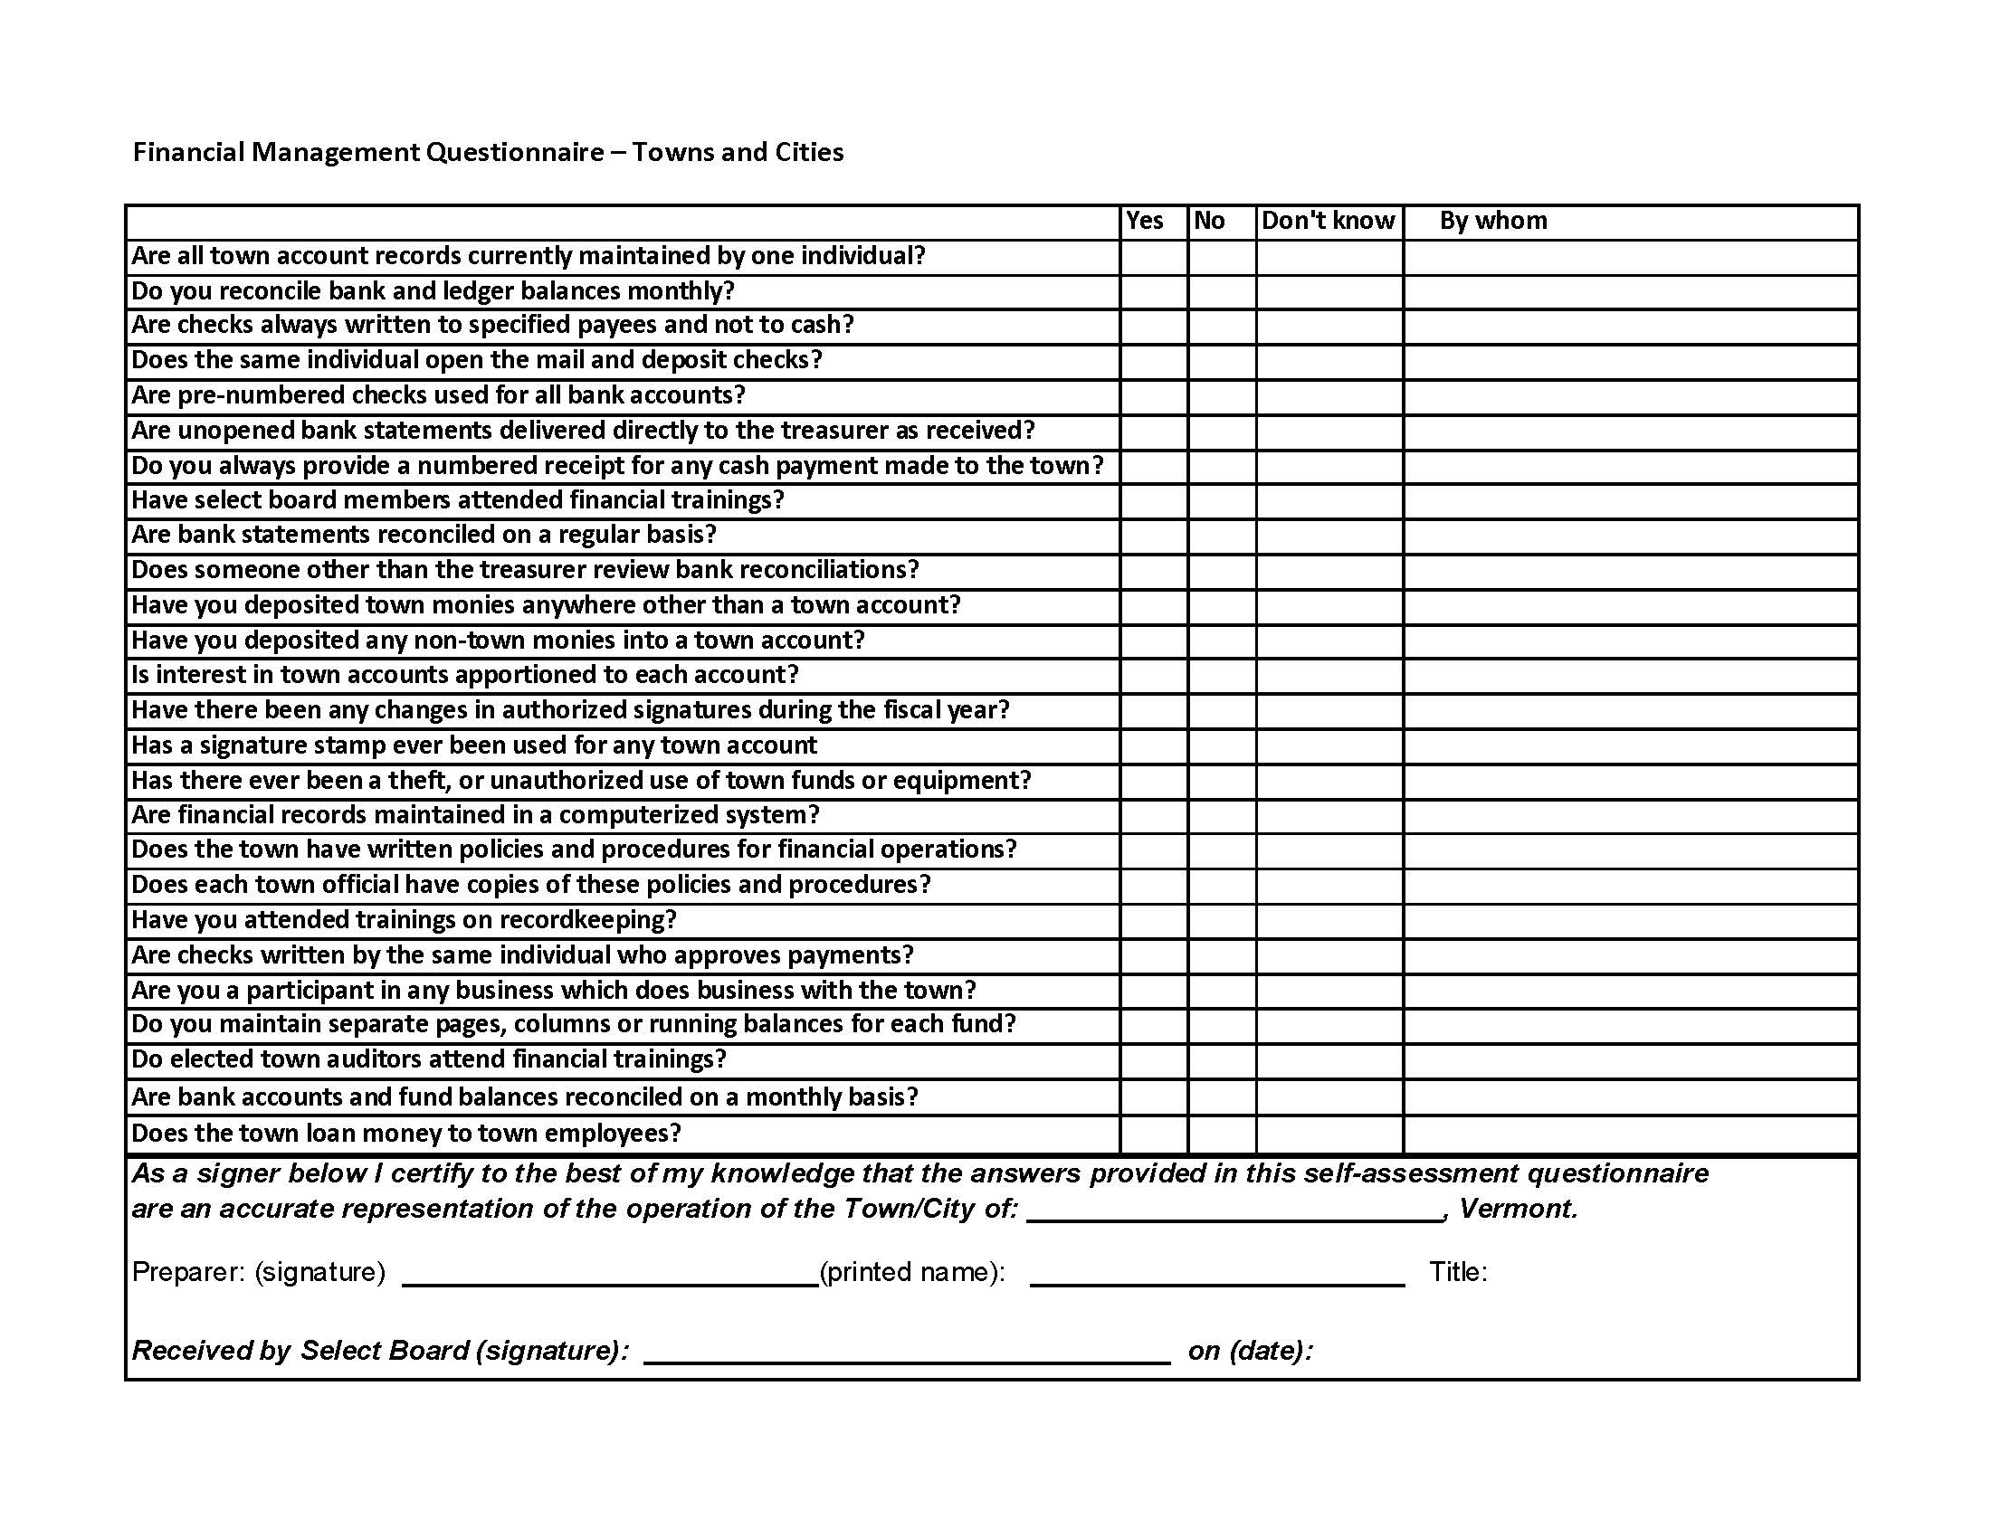
Financial Management Questionnaire
Must be completed annually by the treasurer and submitted to the Selectboard.
Auditors will look for this.

Slide 17
Audits
Auditors
Elected/Appointed or Independent Auditor
Types of Audits
Single Audit
VLCT Workers Comp Audit
VLCT Payroll Audit
Grant Audit
VT Subrecipient Report
State Highway funds for their audit by Feds
Independent Audit
Best annually or at very least every 3 years
Back up Back up Back up
  3 ring Binders for records/reports or computer folder system
  Keep the receipts – when in doubt – keep it
NEMRC specific
  Transfer reports, General Journal entries, Cash receipts – 3 ring binders for each module
  Quickbooks?
Audit findings
  Within the audit report in the conditions statement of weakness or non-compliance
  Indicates what needs to be addressed
  Leads to corrective action plan
  Look for Audit report and review your audit

Slide 18
Cash Handling – Cash Receipts
Collecting, Holding, distributing payments
Monitor for spending, borrowing and investing
See Strafford’s:
Cash Receipts, Petty Cash, Debit Card and Return Check Policy
Cash Receipts
Receipt of actual cash – counted twice, and/or by two people if possible
Record into the correct revenue account and keep adequate information to identify the source.
Policy of no cash, return post dated checks
Segregation of Duties when possible
Funds Into the Bank ASAP
Hold funds and make the best use of them
Keep them in a safe and secure environment

Slide 19
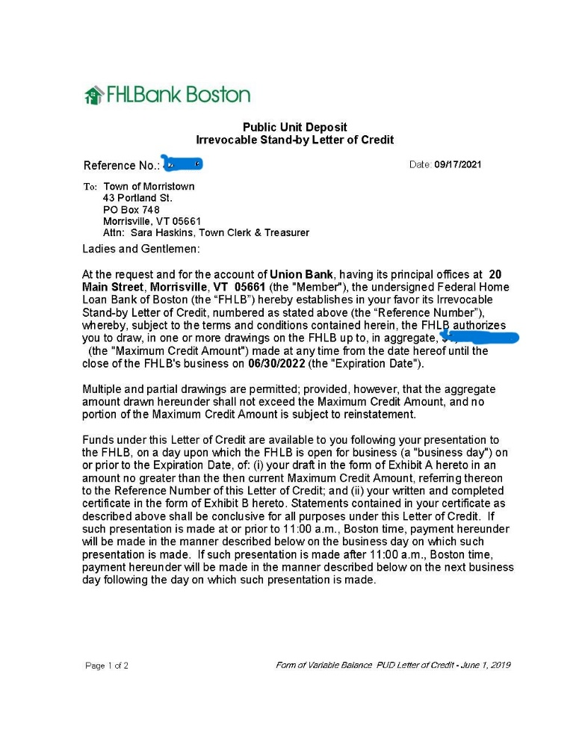
Cash Handling – Banking
Form a relationship with your bank
Second signer - appoint an assistant
Check bank accounts daily
FDIC up to $250,000 & additionally bank will get a CEDARS – a certificate of deposit letter with the amount of coverage annually
Competitive Bid for services
Review services available
Remote capture

Slide 20
Cash Handling- Credit Cards
Different providers
Different fees
Fees paid by customers vs consumed by the Town

Slide 21
Cash Handling - Investing
Must ensure safeguard of the principle
Liquidity – sufficient funds available when needed
Town Investment Policy

Slide 22
Reconciliation
Balance checkbook to the bank statement by the 15th of the month
Look at the reconciliation
Have a second person review and sign it
Review by your Town Manager/Administrator, Auditor or Board Chair
GL Reconciliation – comparing your accounting record to the transactions

Slide 23
Reports for Town Report
Budget
Budget (overview-summary-at a glance)
List Assets
Schedule of Indebtedness
Balance Sheets
Revenues and Expenses
Grant Award Report
Auditor Report
Statement of Taxes Raised
Delinquent Tax Report if a DTC
Town Meeting Warning
See other Town reports for ideas

Slide 24
Loans
RPF
Loan Programs
    Banks
    VT Bond Bank - generally much lower interest rate
    Interfund loans
Tax Anticipation Note
Arbitrage
Borrowing over 5 years
Resolution
Certificate of posting

Slide 25
Making Payments/ Accounts Payable
Coding of invoices – by Department heads
Warrants – A/P and payroll
Warrants signed by Selectboard before releasing payments
Motion for standing order for Chair/Vice Chair to sign to release payments
Online payments – still with warrant
Scammers - always handle payroll changes IN PERSON

Slide 26
Unclaimed Property
The Unclaimed Property Division of the Vermont State Treasurer Office reunites Vermont residents with lost and/or abandoned assets.
Must report any unclaimed property to the state annually
To search for unclaimed property, search the state’s database: www.missingmoney.vermont.gov

