Slide 1
Checklist Cleanup
VMCTA First Thursdays
Lori Bjornlund
sos.elections@vermont.gov
802-828-0588

Slide 2
Reminders
If you are not receiving bulletins from our office, let us know.
Best way to reach the Elections Division, 802-828-0588 & Sos.elections@vermont.gov
Note: statute does not permit a systematic review of the entire checklist within 90 days of an election (May 13th, 2026). Date will be different if you have any local elections.
Biennial checklist cleanup should have been completed by September 15th 2025.
Certification of completion sent to VT SOS, Elections by September 20th.
Performing data cleanup will help voters log into the Voter Portal & improve the mailing of General Election ballots to all voters.

Slide 3
Agenda
Unverified Voters – DL# or SSN
Missing DL#
Missing date of birth
Middle initial in first name field
Challenging or Purging voters

Slide 4
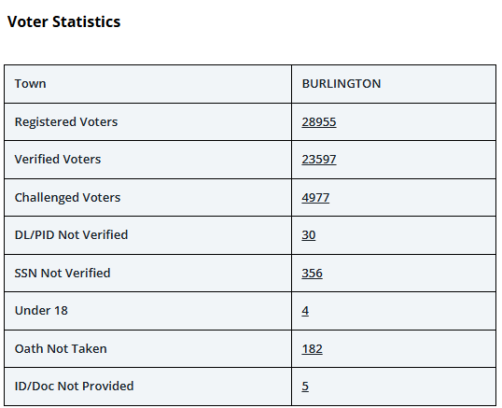
Voter Statistics Review
Found on the Reminders page when logging into VEMS.
  Gives an overview of voters within a given status.
  Each number can be clicked on which will bring you to Voter Inquiries.
  Review periodically.

Slide 5
Unverified Driver’s License or SSN
If any voters are in this status, export an excel of the data.
Go to Inquiries > DMV Voter Inquiries (if SSN is unverified see if the voter now has a VT DL#).
  Use the voter inquiries export to search the DMV data.
    If a match is found.
    Verify – last, first or middle names match voter record data.
    If no DOB is in the voter record capture that from the DMV data.

Slide 6
Missing DL# or SSN
Voter Inquiries > type 00000000 in the DL# field & 0000 in the SSN field to search data.
  Export data to excel.
  Perform each of the search criteria individually to get different results.
DMV Voter Inquiries
  Use the voter inquiries export to search the DMV data.

Slide 7
Missing DOB
Voter Inquiries – enter 01/01/1900 in the DOB field
  These voter most likely will be on the exported data for the missing DL or SSN
  You will perform the same DMV Voter Inquiries searches to find the data.

Slide 8
Voter Name
Voter Inquiries > click search > export to excel or csv
In the export file filter, the first name field to find voters with middle initial in the first name field.
Filter voters that may have a suffix in the last name field.
Edit voters to remove incorrect naming conventions to the appropriate field.

Slide 9
Challenge & Purge
Mail returned as undeliverable.
  Voter can be challenged
You see an obituary in the paper.
  Voter can be purged
Someone tells you someone has passed away.
  Search in vital records for a death certificate or in newspaper for an obituary.
    Once found the voter can be purged

Slide 10
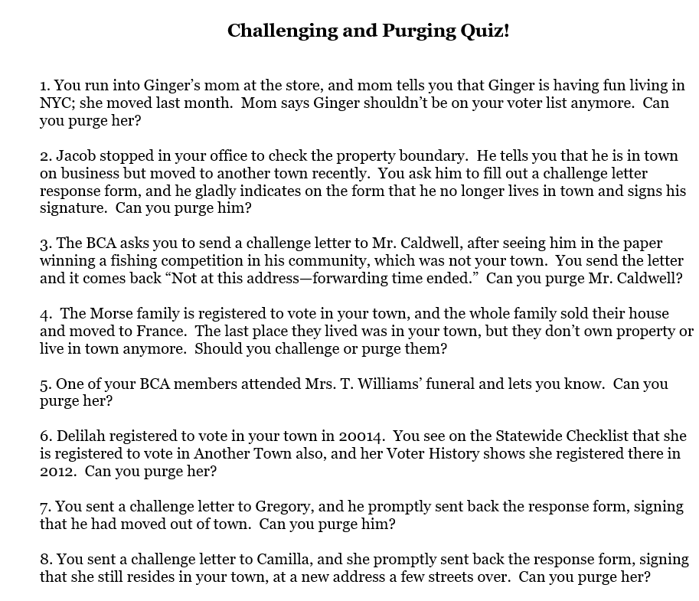

Slide 11
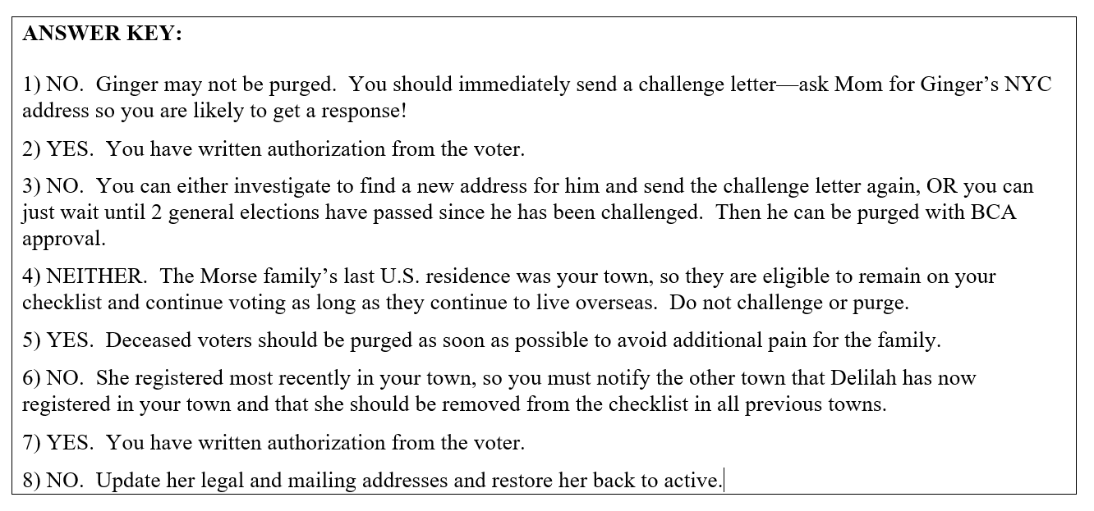

Slide 12
Thank you
Elections Division
Sean Sheehan, Director of Elections
Tammy Sink, Assistant Director of Elections
Lori Bjornlund, Elections Administrator
Dan Brown, Elections Administrator
Gordon Merrick, Elections Administrator
Rosie Casciero, Administrative Services Coordinator

