Slide 1

Policies for Municipal Treasurers
This Photo by Unknown Author is licensed under CC BY-NC-ND
Notes:
Susan Gage, Treasurer and Clerk in Brandon since 2014. Background in Accounting which helps.
Any new treasurers? Do people use NEMRC? Or something else? Size of your offices? Small offices where Treasurer does everything is riskier.
As Treasurers we are the fiscal stewards of the public monies. We want to account for it, help it grow where it can, and help create a fiscal sustainability in our towns.
To do that we should have clear, consistent, guidelines in the form of written policies..
Does anyone NOT have policies in their municipalities?

Slide 2
Introduction to Financial Policies
Purpose and Importance
  Financial policies establish clear guidelines that ensure disciplined and transparent financial management aligned with strategic goals.
Consistency and Continuity
  Policies maintain consistent financial decision-making over time, minimizing dependence on individual judgments or staff changes.
Risk Management and Planning
  Financial policies support municipalities in managing revenues, expenses, reserves, and debt minimizing risk to assets.
Communication and Accountability
  Policies communicate clear decision-making rules internally and demonstrate fiscal responsibility to external stakeholders.
This Photo by Unknown Author is licensed under CC BY-NC-ND
Notes:
1) WHY ARE POLICIES IMPORTANT – ESTABLISH CLEAR GUIDELINES AND TRANSPARENCY
2) CONSISTENCY - Accountability to taxpayers by clarifying financial intent, codifying acceptable practices into policies.
At a high level, financial policies institutionalize good financial management practices so that decision-making does not depend solely on individual judgment or short-term political pressures.
They provide continuity over time, even as staff members or elected officials change, ensuring that the organization remains aligned with long-term objectives.
3) RISK MANAGEMENT - Financial policies also help organizations proactively address uncertainty by setting expectations for how revenues, expenditures, reserves, and debt will be managed thereby reducing risk to assets.
“Coventry Issue” risk of money disappearing- no cash policy? No policy around financial review or audit?
4) ACCOUNTABILITY - Another critical role of financial policies is communication. Policies clearly explain to internal staff how financial decisions should be made and implemented, while also signaling to external audiences—such as rating agencies, auditors, and the public—that the municipality is committed to prudent fiscal stewardship.
By establishing clear rules and boundaries, financial policies reduce ambiguity, support ethical behavior, and promote consistency in financial operations. Overall, financial policies are not just technical documents; they are strategic tools that guide behavior, support credibility, and strengthen the long-term financial health of a municipality.

Slide 3

Financial Management Policies
Budget Development and Approval
  Budget policies define timelines, roles, and criteria to align spending with strategic priorities and community needs.
Revenue and Asset Management
  Policies ensure fair collection of revenues and guide maintenance and replacement of municipal infrastructure.
Auditing and Financial Reporting
  Regular audits and transparent reporting promote accountability and identify inefficiencies early.
Financial Resilience and Sustainability
  Policies establish guidelines for reserves, debt management, and emergency spending to support fiscal resilience.
Notes:
What areas do we look at when establishing financial policies?
1) Budgeting – When do we start process, who is involved, what are the goals?
2) Revenue and Asset Management – expenditures – do we accept cash, credit cards, checks? Who can purchase things? Are there limits to amounts people can purchase?
3) Auditing and financial reporting – what types of reports, frequency, outside audits?
4) Financial resilience and sustainability – fund balance policy, capital account fundings?
Broad sweep of financial policies include budgeting and budget approval, revenue and asset management, auditing and financial reporting, financial resilience
Policies guide how public funds are planned, collected, spent, and monitored, ensuring responsible stewardship of taxpayer resources.
Fortunately we have the VMCTA, VLCT, and the Secretary of State to help us define policy needs, and to help us create policies.
Developing effective financial policies is a deliberate and structured process that begins with clearly defining the problem or issue the policy is intended to address. This initial step ensures that the policy is purposeful and directly linked to organizational needs, risks, or strategic goals. Without a clearly defined problem, policies risk being overly generic or misaligned with actual challenges.
The next step involves drafting the policy itself. During this phase, organizations should consider applicable legal requirements, industry best practices, and experiences of peer organizations. Input from finance staff, legal counsel, and other stakeholders can help ensure the policy is practical, compliant, and comprehensive. In some cases, public input or feedback from governing bodies may also be appropriate.
Once drafted, the policy should be reviewed and formally presented to senior management and elected officials. This step promotes transparency, builds understanding, and allows decision-makers to ask questions or request revisions. Formal adoption by the governing body gives the policy authority and legitimacy. Finally, implementation and communication are critical. Policies must be shared with staff, integrated into procedures, and referenced during budgeting and financial decisions to ensure they are actively used rather than simply filed away.
Organizations typically adopt a comprehensive framework of financial policies that address multiple aspects of financial management. One of the most common categories is fund balance and reserve policies, which define appropriate reserve levels for the general fund and other funds. These policies help ensure that sufficient resources are available to manage cash flow, respond to emergencies, and weather economic downturns.
Debt policies are another critical category, establishing guidelines for when debt may be issued, acceptable debt levels, and repayment structures. These policies promote responsible borrowing and protect the organization from overleveraging. Investment policies define how public funds are invested, emphasizing safety, liquidity, and yield, while ensuring compliance with legal requirements.
Additional policy areas often include revenue policies, which address diversification, elasticity, and reliability of revenue sources, and expenditure policies, which guide spending growth and cost controls. Capital policies govern planning and financing for infrastructure and long-term assets, while operating budget policies emphasize structural balance and recurring revenues. Other common policies cover grants management, procurement, risk management, internal controls, accounting and financial reporting, and long-term financial planning. Together, these policies form an integrated system that supports financial stability and strategic decision-making.

Slide 4
1. General fund reserves. Policies governing the amount of resources to be held in reserve and conditions under which reserves can be used.
2. Reserves in other funds. Policies for other funds (especially enterprise funds) that serve a similar purpose to general fund reserve policies.
3. Structurally balanced budget. Policies that offer a distinction between satisfying the statutory definition and achieving a true structurally balanced budget.
GFOA
Notes:
1) Define required reserve levels and conditions for use
2) Provide structure for reserves in enterprise and special revenue funds
3) Distinguish statutory balanced budgets from structurally balanced budgets
4) Reinforce fiscal discipline and stability in annual budgeting
Municipal financial policies regarding general fund reserves ensure stability, maintaining essential services during economic downturns or unexpected emergencies. The Government Finance Officers Association (GFOA) recommends maintaining at least two months of operating expenditures or revenues (approx. 16.7% or 20% or more) as unrestricted reserves. Policies should dictate target levels, use cases, and replenishment plans.
Other funds reserves – policies should define use for the funds and restrict other uses
A structurally balanced municipal budget ensures recurring revenues equal or exceed recurring expenditures, providing long-term sustainability rather than just meeting statutory balance requirements. Municipal financial policies must enforce this by forecasting revenues, restricting the use of one-time funds for ongoing expenses, and maintaining reserves.

Slide 5
FUND BALANCE POLICY
Click here

Slide 6
4. Debt. Policies that govern the use of government debt, including permissible debt instruments, conditions under which debt may be used, allowable levels of debt, and compliance with continuing disclosure requirements.
5. Investment. Policies that provide guidance on the investment of public funds, including permissible investment instruments, standards of care for invested funds, and the role of staff and professional advisors in the investment program.
6. Economic development. Policies that address a local government’s use of subsidies or other incentives to encourage private development.
GFOA
Notes:
Title: Overview: Debt, Investment & Economic Development
Bullets:
Establish responsible use and limits for municipal debt
Define permissible investment instruments and standards of care
Clarify roles of staff and advisors in managing investments
Guide use of incentives to support local economic development

Slide 7
INVESTMENT POLICY
Click here
Notes:
PULL UP THE INVESTMENT POLICY

Slide 8
7. Accounting and financial reporting. Policies that establish and guide the use of an audit committee, endorse key accounting principles, and that ensure external audits are properly performed.
8. Risk management and internal controls. Policies that address traditional views of risk management and internal control, as well as more modern concepts of "enterprise risk management.“
9. Procurement. Policies that are most essential for adoption by the governing board in order to encourage efficient, effective and fair public procurement.
GFOA
Notes:
Title: Overview: Reporting, Risk & Procurement
Bullets:
Establish accounting standards and oversight for audits
Strengthen internal controls and enterprise risk‑management practices
Ensure transparent, fair, and efficient procurement processes
Promote accountability in financial operations

Slide 9
INTERNAL CONTROL CHECKLIST
Click here
Notes:
PULL UP INTERNAL CONTROL CHECKLIST FROM VLCT
ALSO CHECK OUT ST JOHNSBURY

Slide 10
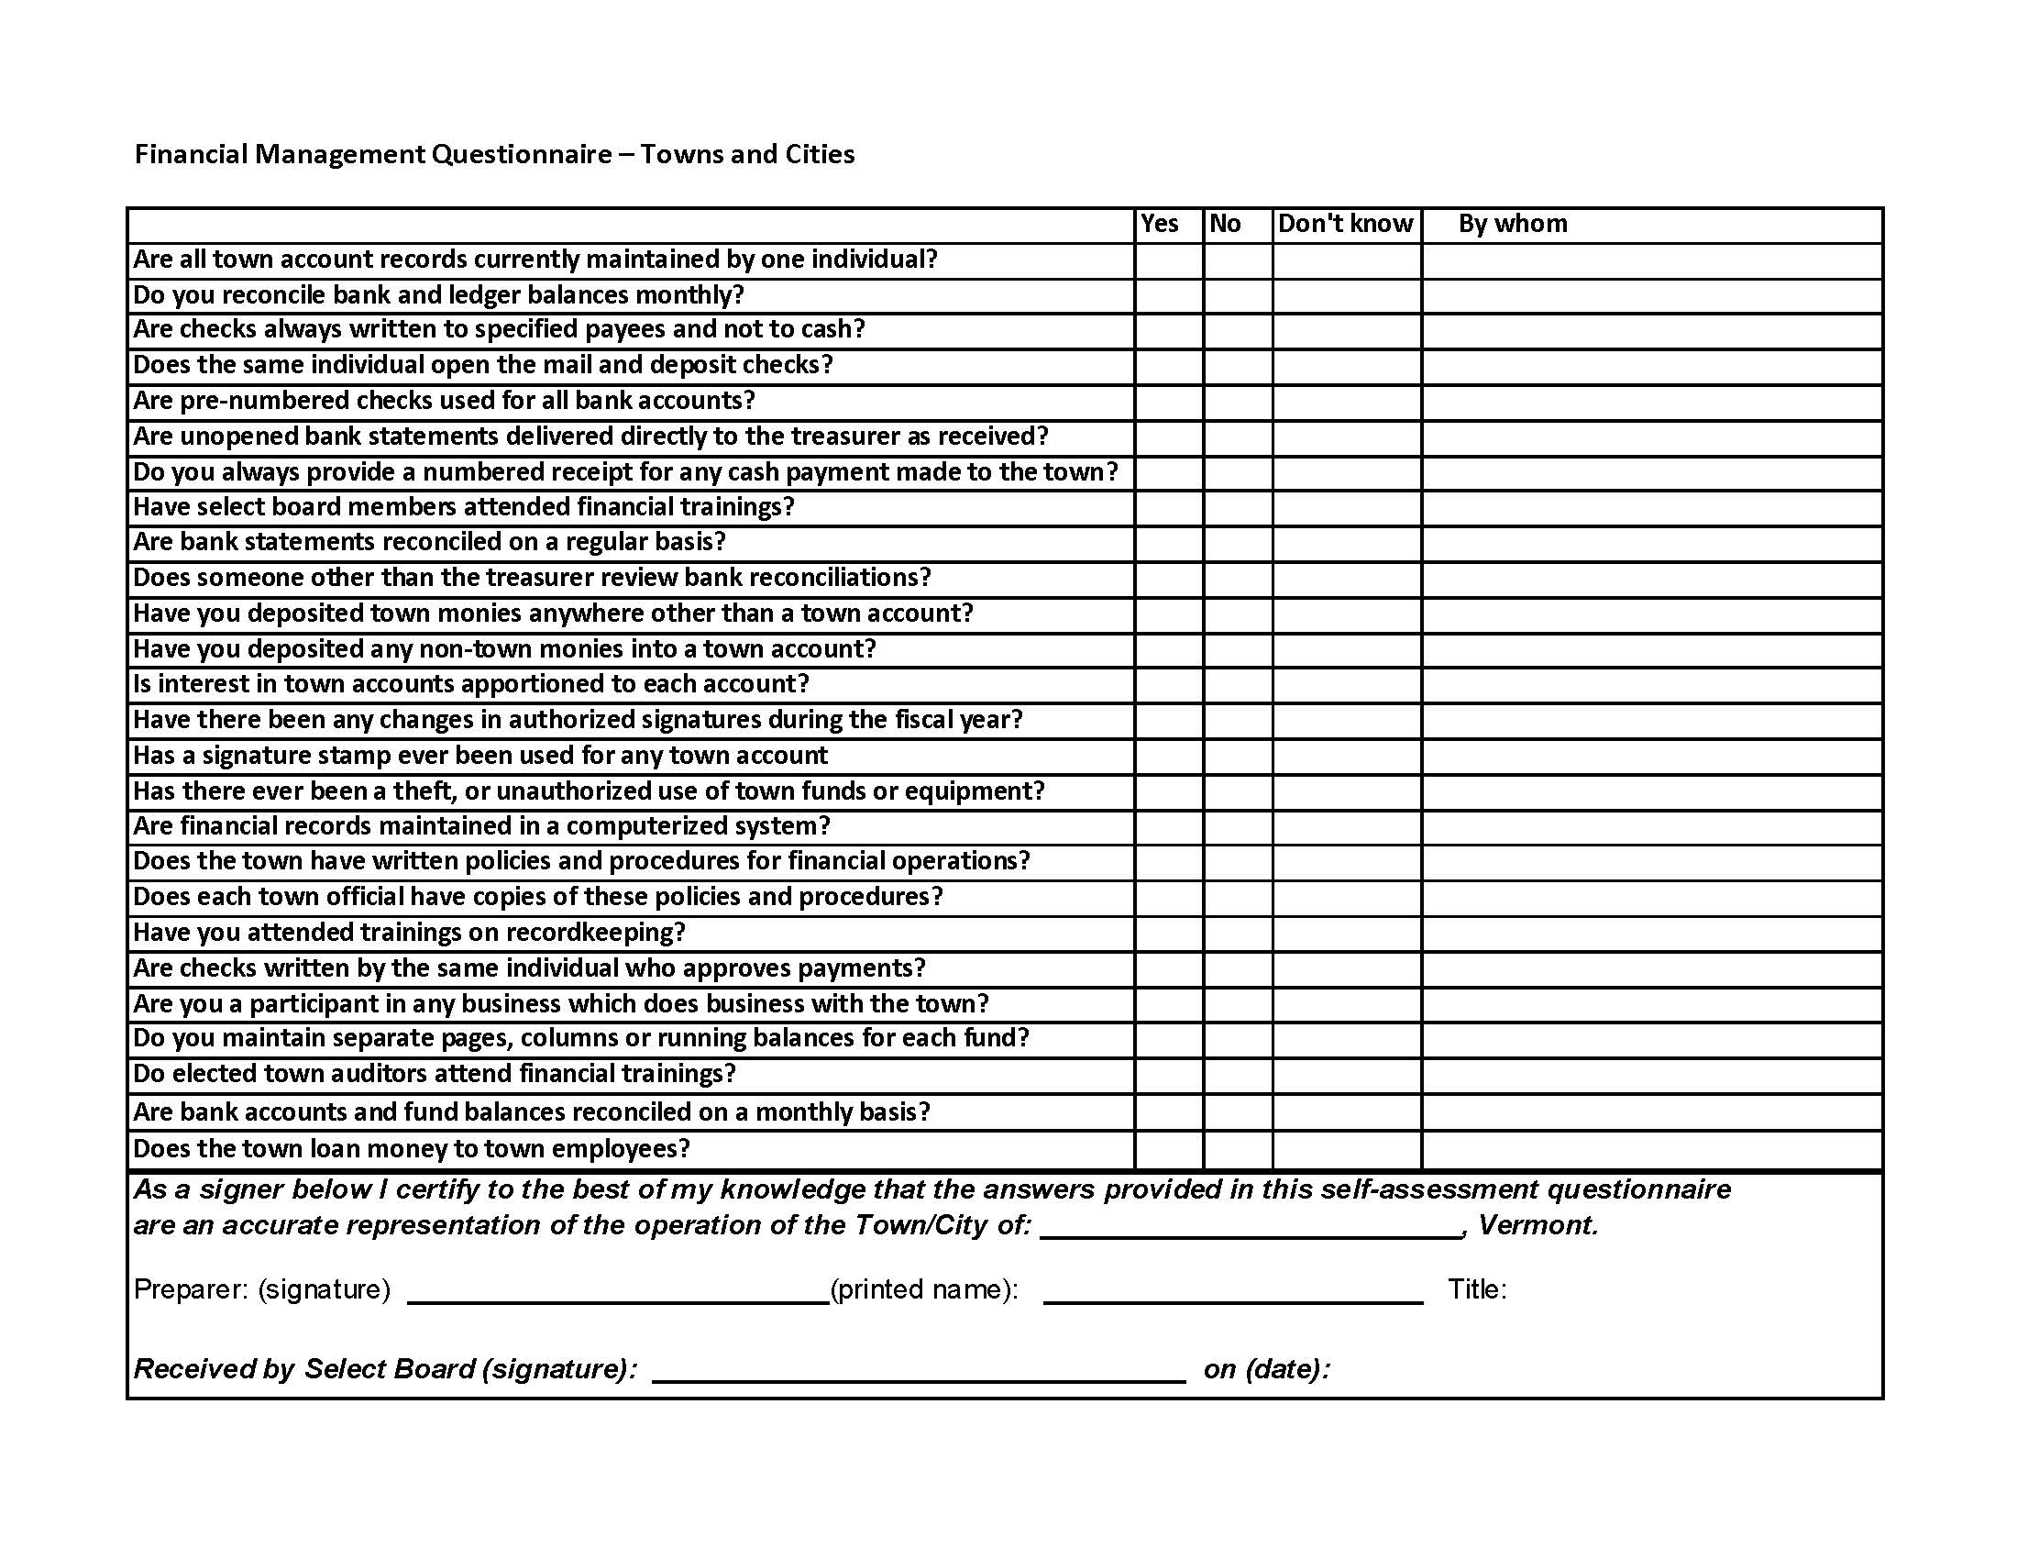
Financial Management Questionnaire
Must be completed annually by the treasurer and submitted to the Selectboard.
Auditors will look for this.

Slide 11
10. Long-term financial planning. A policy that commits the organization to taking a long-term approach to financial health.
11. Grants. Policies that deal with the administration and grants process.
12. Capital. Policies that cover the lifecycle of capital assets, including capital improvement planning, capital budgeting, project management, and asset maintenance.
GFOA
Notes:
Title: Overview: Long‑Term Planning, Grants & Capital
Bullets:
Commit the organization to long‑term financial planning
Standardize grant management and compliance processes
Provide structure for capital planning, budgeting, and asset maintenance
Support sustainable infrastructure and lifecycle stewardship

Slide 12
CAPITAL PROGRAM AND BUDGET POLICY
Click here

Slide 13
13. Revenues. Policy guidance through the designing of efficient and effective revenue systems that guarantee the generation of adequate public resources to meet expenditure obligations.
14. Expenditures. Policies addressing a range of issues around how the money is expended, including personnel, outsourcing, and funding long-term liabilities.
15. Operating budget. Policies that describe essential features of the budget development process and form, as well as principles that guide budgetary decision making.
GFOA

Slide 14
CASH RECEIPTS, PETTY CASH, RETURNED CHECK POLICY
Click here

Slide 15
PROCUREMENT POLICY
Click here

Slide 16
Why Policies Matter
Protecting Public Funds
  Policies ensure ethical, transparent management of public resources, reinforcing taxpayer trust and financial responsibility.
Ensuring Stability and Continuity
  Written policies maintain governance consistency despite staff or official changes, supporting long-term community goals.
Clarifying Roles and Accountability
  Clear policies define authority and responsibilities, reducing conflict and enhancing transparency and internal controls.
Supporting Long-Term Sustainability
  Policies promote forward-thinking decisions in planning, reserves, and debt management for sustainable governance.
Notes:
Policies play a critical role in effective municipal governance by providing a clear, consistent framework for how decisions are made and how public resources are managed. At their core, policies protect public funds and reinforce public trust. Taxpayers expect their money to be handled responsibly, ethically, and transparently, and well‑defined policies help ensure that financial practices meet those expectations. By establishing agreed‑upon rules in advance, municipalities reduce the risk of arbitrary decisions and demonstrate a commitment to fairness and stewardship.
Another key function of policies is ensuring consistency and continuity over time. Municipal governments experience regular turnover among staff, elected officials, and board members. Without written policies, institutional knowledge can be lost, and decision‑making can shift unpredictably from one administration to the next. Policies provide stability by guiding actions regardless of who is in office, helping communities stay aligned with long‑term goals rather than short‑term pressures.
Policies also clarify roles, responsibilities, and accountability. When expectations are clearly documented, officials and staff understand their authority and limitations, reducing confusion and conflict. This clarity supports transparency, makes audits and reviews more effective, and strengthens internal controls. In addition, strong policies reduce financial and operational risk by establishing safeguards, review processes, and standards for handling funds, contracts, and investments.
Finally, policies support sound, long‑term decision‑making and sustainability. They encourage municipalities to look beyond immediate needs and consider future impacts, such as reserve levels, capital planning, and debt management. Together, these elements show that policies are not just administrative requirements, but essential tools that turn good intentions into reliable, repeatable, and trustworthy governance for the community.

Slide 17
Q & A
https://brandonvt.sharepoint.com/Shared%20Documents/USERS/WAD/TRAINING%20BANKING%20RFPs/policy%20training%20spring%202026/examples%20of%20policies_101.pdf

Slide 18
Resources
https://vmcta.org/
https://www.vtgfoa.org/
https://www.gfoa.org/
https://nesgfoa.com/
https://www.vlct.org/
https://www.vermonttreasurer.gov/
https://finance.vermont.gov/reports-and-publications/town-payment-reports-and-data
https://auditor.vermont.gov/
https://sam.gov/content/home

